Slide 1






Foundations of
Quantum Information Science (QIS 102)
Dave Biersach
Brookhaven National Laboratory
dbiersach@bnl.gov
Session 10
Numerical
Analysis

Slide 2
Session 10 – Part 1 of 2 – Topics
Numerically compute and plot the derivatives of a function using Fermat's Difference Quotient and compare its accuracy to the Central Difference Formula
Derive Simpson's Rule for numerical integration and compare this to the accuracy of the left-hand rule
Leverage the SciPy Integration module and compare its accuracy to our fixed-width Simpson's Rule implementation
Numerically integrate the Probability Density Function (PDF) of the Gaussian Standard Normal distribution
Consider the advantages an adaptative quadrature approach versus sticking with fixed-width intervals

Slide 3
Important Python Patterns
Numpy vectorized operations (broadcasting, element-wise ops)
Range intervals (,] and Slicing Syntax [::] and -1 step
Print format specifiers, f-strings, replacement fields
Tuples (packing and unpacking, immutable elements, indexing)
Using for loops (ranged-based vs. sequence type iteration)
Using enumerate in for loops (receiving index and value tuples)
List Comprehensions (for “in the middle”, set, dictionary, generator)
Ternary Operator (value_if_true if condition else value_if_false)
Using an underscore _ (for loops & tuple unpacking)
Matplotlib Pyplot (figure vs. axes methods, projections, subplots)

Slide 4
Important Python Patterns
Using an asterisk * (fully unpack an iterable sequence type)
Context managers (with) for data file input/output
Flow control: pass, break, continue
Function parameters (positional, /, * , defaults, *args, **kwargs)
Strings & Unicode (ASCII vs. UTF-8, bytes vs. bytearray)
Lambda (anonymous) functions (single expression, map/filter)
Function currying (functions as parameters to other functions)
Decorators (@njit, etc.)
Exception Handling (try, except, else, finally)

Slide 5
Common Import Patterns and Aliases
import datetime as dt
import flask as fl
import keras as ks
import matplotlib.pyplot as plt
import numpy as np
import pandas as pd
import scipy as sp
import seaborn as sns
import sklearn as skl
import sympy as sy
import tensorflow as tf
from math import sqrt
from matplotlib.ticker import MultipleLocator
from mpmath import mp, mpf
from numba import njit
from pathlib import Path
from random import randint, choice
from scipy import optimize, stats
from scipy.integrate import quad, solve_ivp
import collections
import json
import logging
import os
import re
import sys
import time
import torch

Slide 6
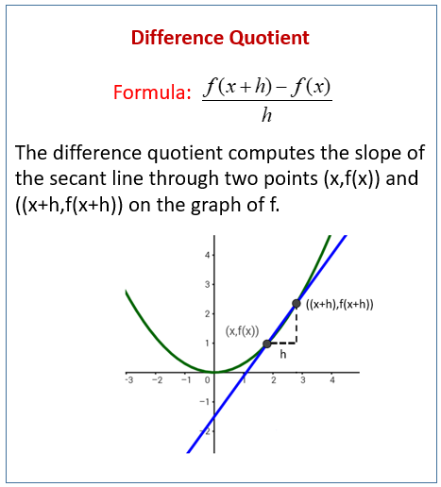
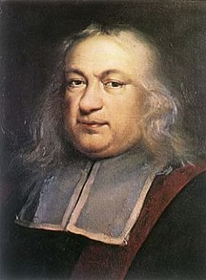
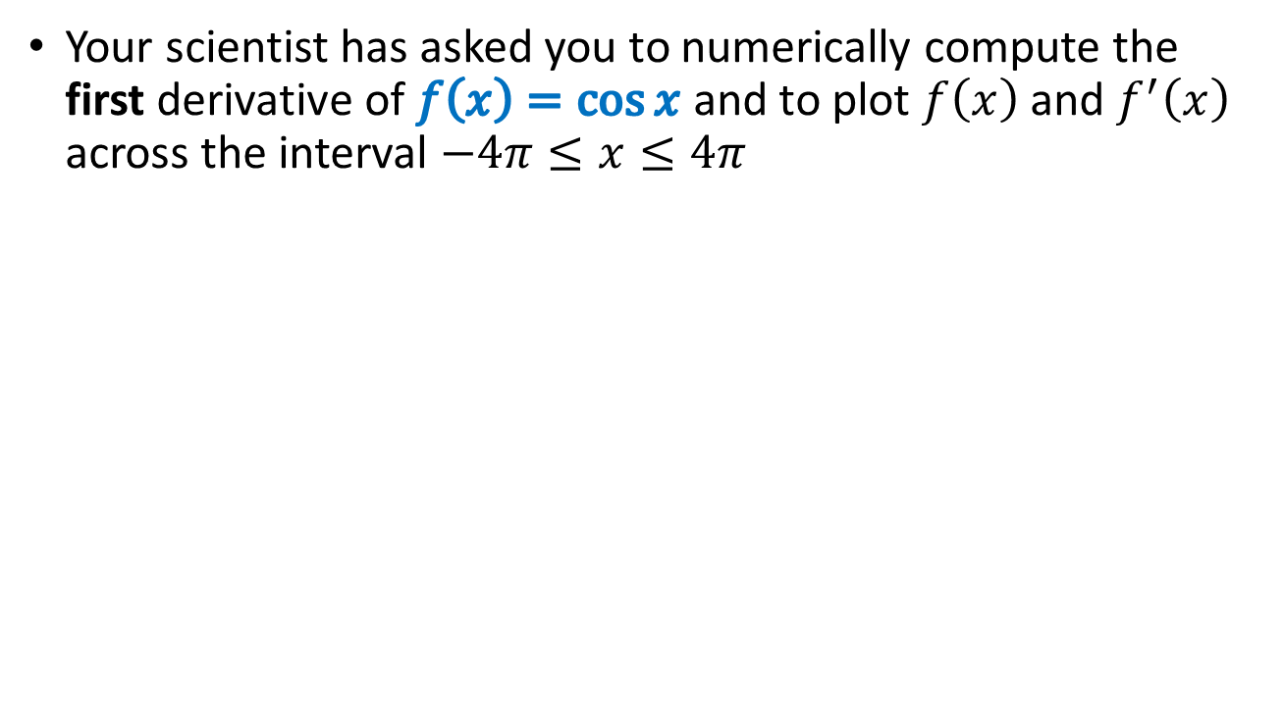
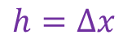
Numerical Differentiation
Your scientist has asked you to numerically compute the first derivative of $f\left(x\right)=\cos{x}$ and to plot $f\left(x\right)$ and $f^{′}\left(x\right)$ across the interval $−4π≤x≤4π$
$$h=Δx$$
Pierre de Fermat
1607-1665

Slide 7
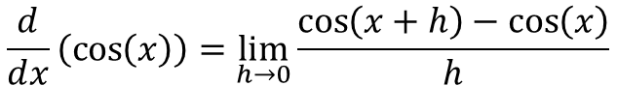
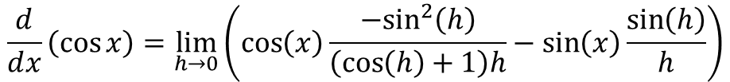

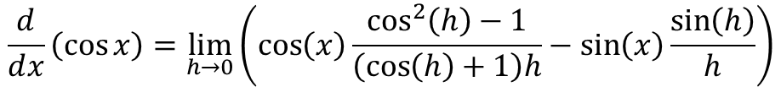
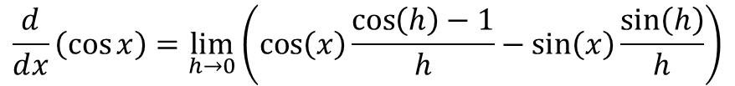
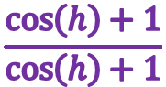
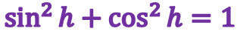
Derivative of $\cos{x}$
$$\frac{d}{ⅆx}\left(\cos\left(x\right)\right)=\lim_{h→0}{\frac{\cos\left(x+h\right)−\cos\left(x\right)}{h}}$$
Angle Sum Identity
$$\frac{d}{ⅆx}\left(\cos{x}\right)=\lim_{h→0}{\frac{\left(\cos\left(x\right)\cos\left(h\right)−\sin\left(x\right)\sin\left(h\right)\right)−\cos\left(x\right)}{h}}$$
Collect like terms
$$\frac{d}{ⅆx}\left(\cos{x}\right)=\lim_{h→0}\left(\cos\left(x\right)\frac{\cos\left(h\right)−1}{h}−\sin\left(x\right)\frac{\sin\left(h\right)}{h}\right)$$
Multiply By:
$$\frac{\cos\left(h\right)+1}{\cos\left(h\right)+1}$$
$$\frac{d}{ⅆx}\left(\cos{x}\right)=\lim_{h→0}\left(\cos\left(x\right)\frac{\cos^{2}\left(h\right)−1}{\left(\cos\left(h\right)+1\right)h}−\sin\left(x\right)\frac{\sin\left(h\right)}{h}\right)$$
$$\sin^{2}{h}+\cos^{2}{h}=1$$
$$\frac{d}{ⅆx}\left(\cos{x}\right)=\lim_{h→0}\left(\cos\left(x\right)\frac{{−sin}^{2}\left(h\right)}{\left(\cos\left(h\right)+1\right)h}−\sin\left(x\right)\frac{\sin\left(h\right)}{h}\right)$$

Slide 8
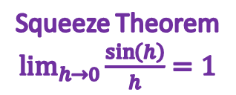
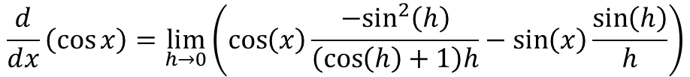
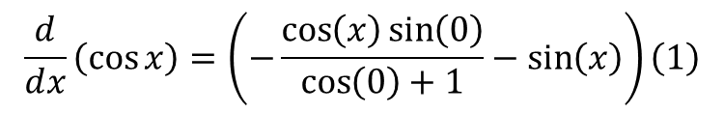
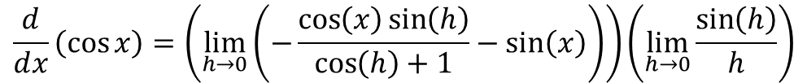
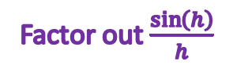
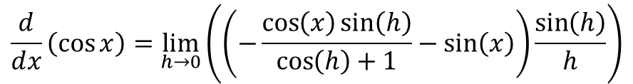

Derivative of $\cos{x}$
$$\frac{d}{ⅆx}\left(\cos{x}\right)=\lim_{h→0}\left(\cos\left(x\right)\frac{{−sin}^{2}\left(h\right)}{\left(\cos\left(h\right)+1\right)h}−\sin\left(x\right)\frac{\sin\left(h\right)}{h}\right)$$
Factor out$\frac{\sin\left(h\right)}{h}$
$$\frac{d}{ⅆx}\left(\cos{x}\right)=\lim_{h→0}\left(\left(−\frac{\cos\left(x\right)\sin\left(h\right)}{\cos\left(h\right)+1}−\sin\left(x\right)\right)\frac{\sin\left(h\right)}{h}\right)$$
Limit of product is product of limits
$$\frac{d}{ⅆx}\left(\cos{x}\right)=\left(\lim_{h→0}\left(−\frac{\cos\left(x\right)\sin\left(h\right)}{\cos\left(h\right)+1}−\sin\left(x\right)\right)\right)\left(\lim_{h→0}{\frac{\sin\left(h\right)}{h}}\right)$$
Squeeze Theorem $\lim_{h→0}{\frac{\sin\left(h\right)}{h}}=1$
$$\frac{d}{ⅆx}\left(\cos{x}\right)=\left(−\frac{\cos\left(x\right)\sin\left(0\right)}{\cos\left(0\right)+1}−\sin\left(x\right)\right)\left(1\right)$$
$$\frac{d}{ⅆx}\left(\cos{x}\right)=−\sin\left(x\right)$$

Slide 9
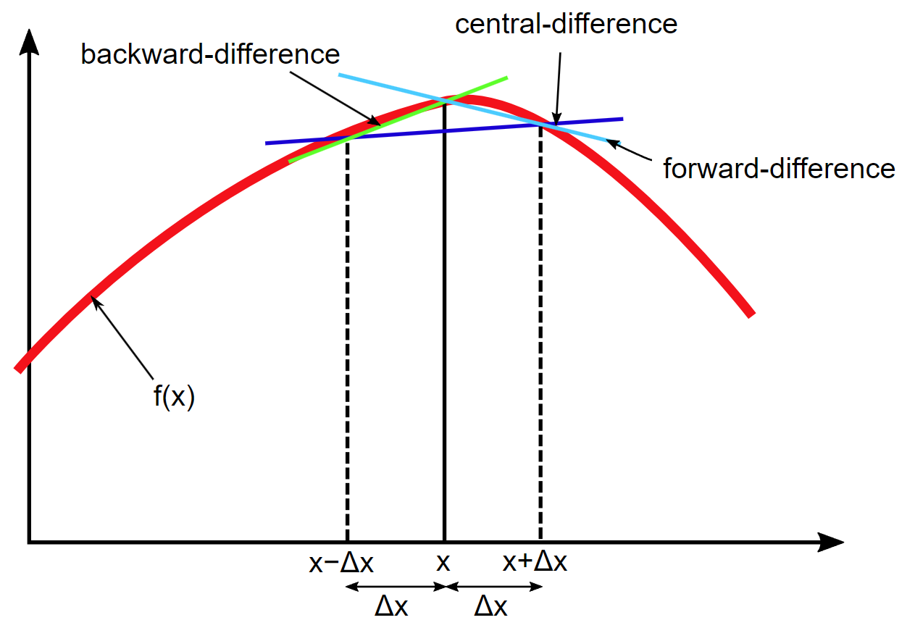
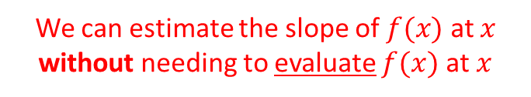
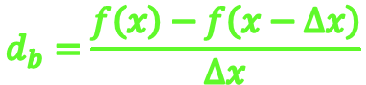
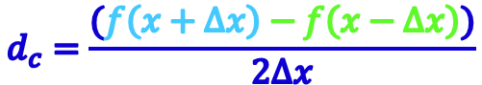
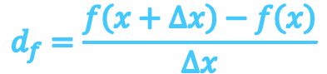
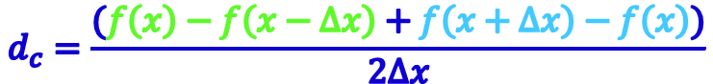
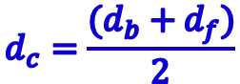
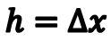
Central Difference Approximation
$$d_{b}=\frac{f\left(x\right)−f\left(x−Δx\right)}{Δx}$$
$$d_{f}=\frac{f\left(x+Δx\right)−f\left(x\right)}{Δx}$$
$$d_{c}=\frac{(d_{b}+d_{f})}{2}$$
$$h=Δx$$
$$d_{c}=\frac{(f\left(x\right)−f\left(x−Δx\right)+f\left(x+Δx\right)−f\left(x\right))}{2Δx}$$
Central Difference Formula is the mean of both slopes
$$d_{c}=\frac{(f\left(x+Δx\right)−f\left(x−Δx\right))}{2Δx}$$
We can estimate the slope of $f(x)$ at $x$ without needing to evaluate $f(x)$ at $x$

Slide 10
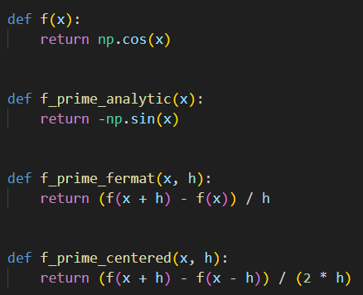
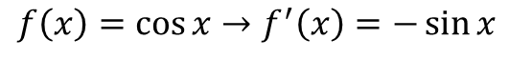
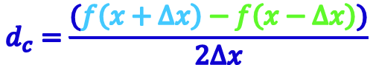
Open fermat_derivative.py
①
②
③
④
$$f\left(x\right)=\cos{x}→f^{′}\left(x\right)=−\sin{x}$$
$$d_{c}=\frac{(f\left(x+Δx\right)−f\left(x−Δx\right))}{2Δx}$$

Slide 11
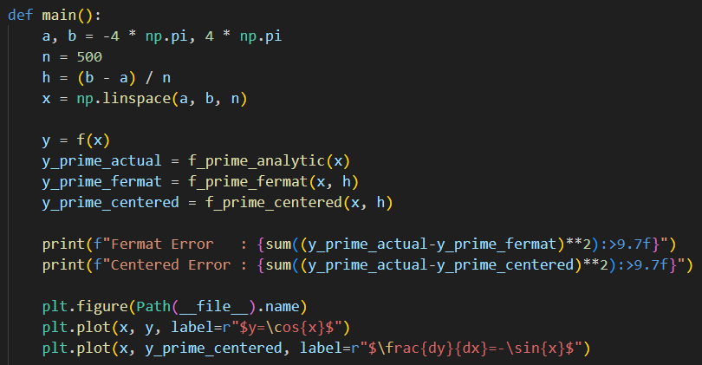
View fermat_derivative.py
①
②
③
④
⑤
⑥
⑦
⑧
We plot the values of y_prime_centered even though we previously calculated the exact values of the 1st derivative (stored in the y_prime_actual array)

Slide 12
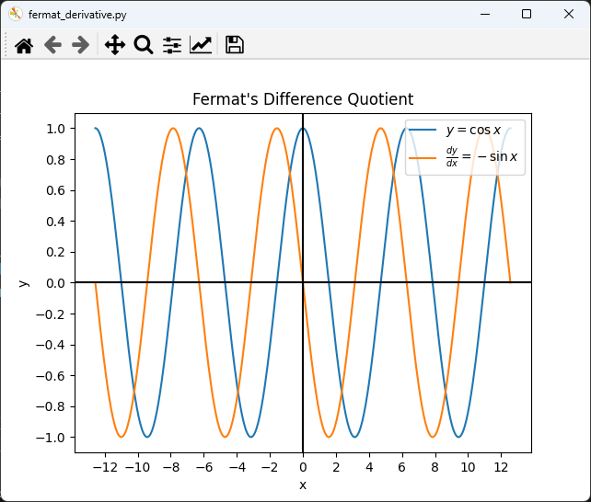
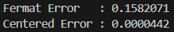
Run fermat_derivative.py
y_prime_centered

Slide 13
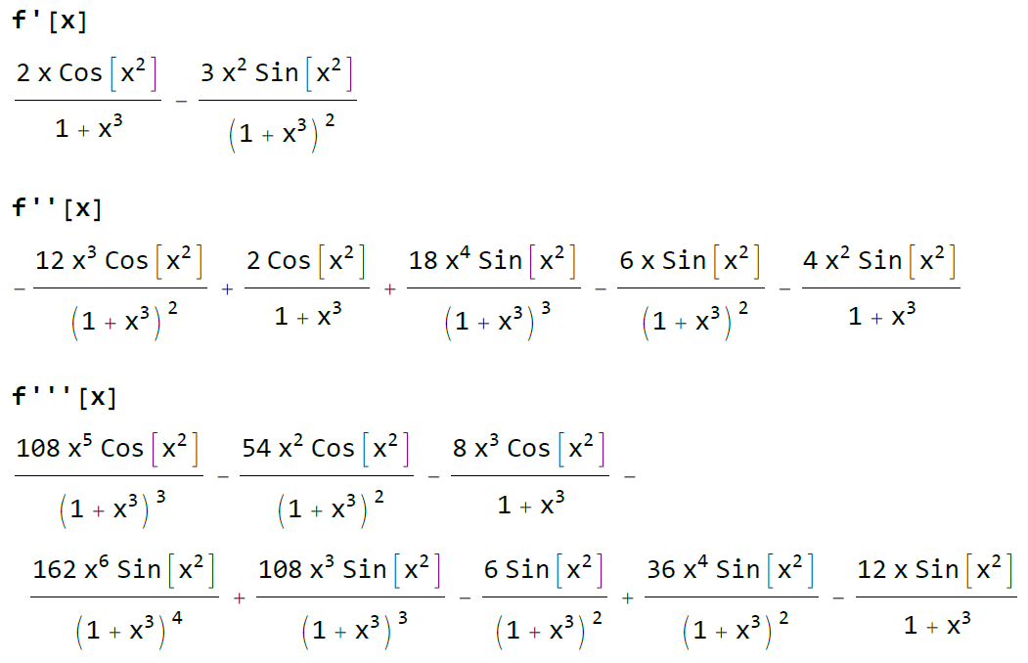
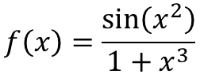
What about higher order derivatives?
$$f\left(x\right)=\frac{\sin\left(x^{2}\right)}{1+x^{3}}$$
Note that as we take higher and higher derivatives, the analytic expression contains more and more terms and exponentially growing coefficients

Slide 14
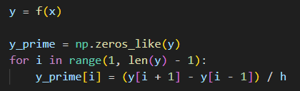
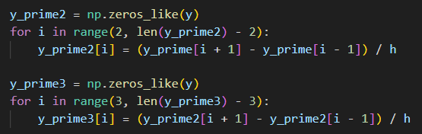
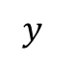
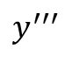
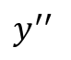
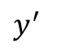
What about higher order derivatives?
Using Central Difference Formula
0
1
2
3
4
5
6
7
8
9
len=10
$$y$$
$$y^{′}$$
0
0
$$y^{′′}$$
0
0
0
0
$$y^{′′′}$$
0
0
0
0
0
0
[0]
[1]
[2]
[3]
[4]
[5]
[-4]
[-3]
[-2]
[-1]
slice

Slide 15
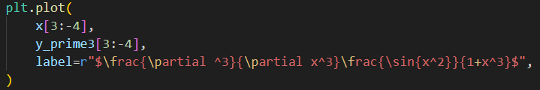
What about higher order derivatives?
Using Central Difference Formula
0
1
2
3
4
5
6
7
8
9
len=10
$$y$$
$$y^{′}$$
0
0
$$y^{′′}$$
0
0
0
0
$$y^{′′′}$$
0
0
0
0
0
0
[0]
[1]
[2]
[3]
[4]
[5]
[-4]
[-3]
[-2]
[-1]
slice

Slide 16
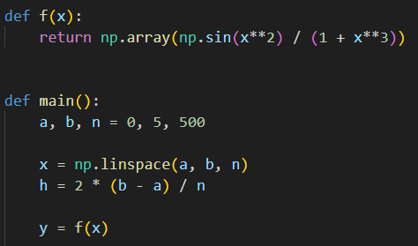
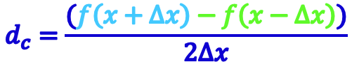
Open third_derivative.py
$$f\left(x\right)=\frac{\sin\left(x^{2}\right)}{1+x^{3}}$$
①
②
③
$$d_{c}=\frac{(f\left(x+Δx\right)−f\left(x−Δx\right))}{2Δx}$$

Slide 17
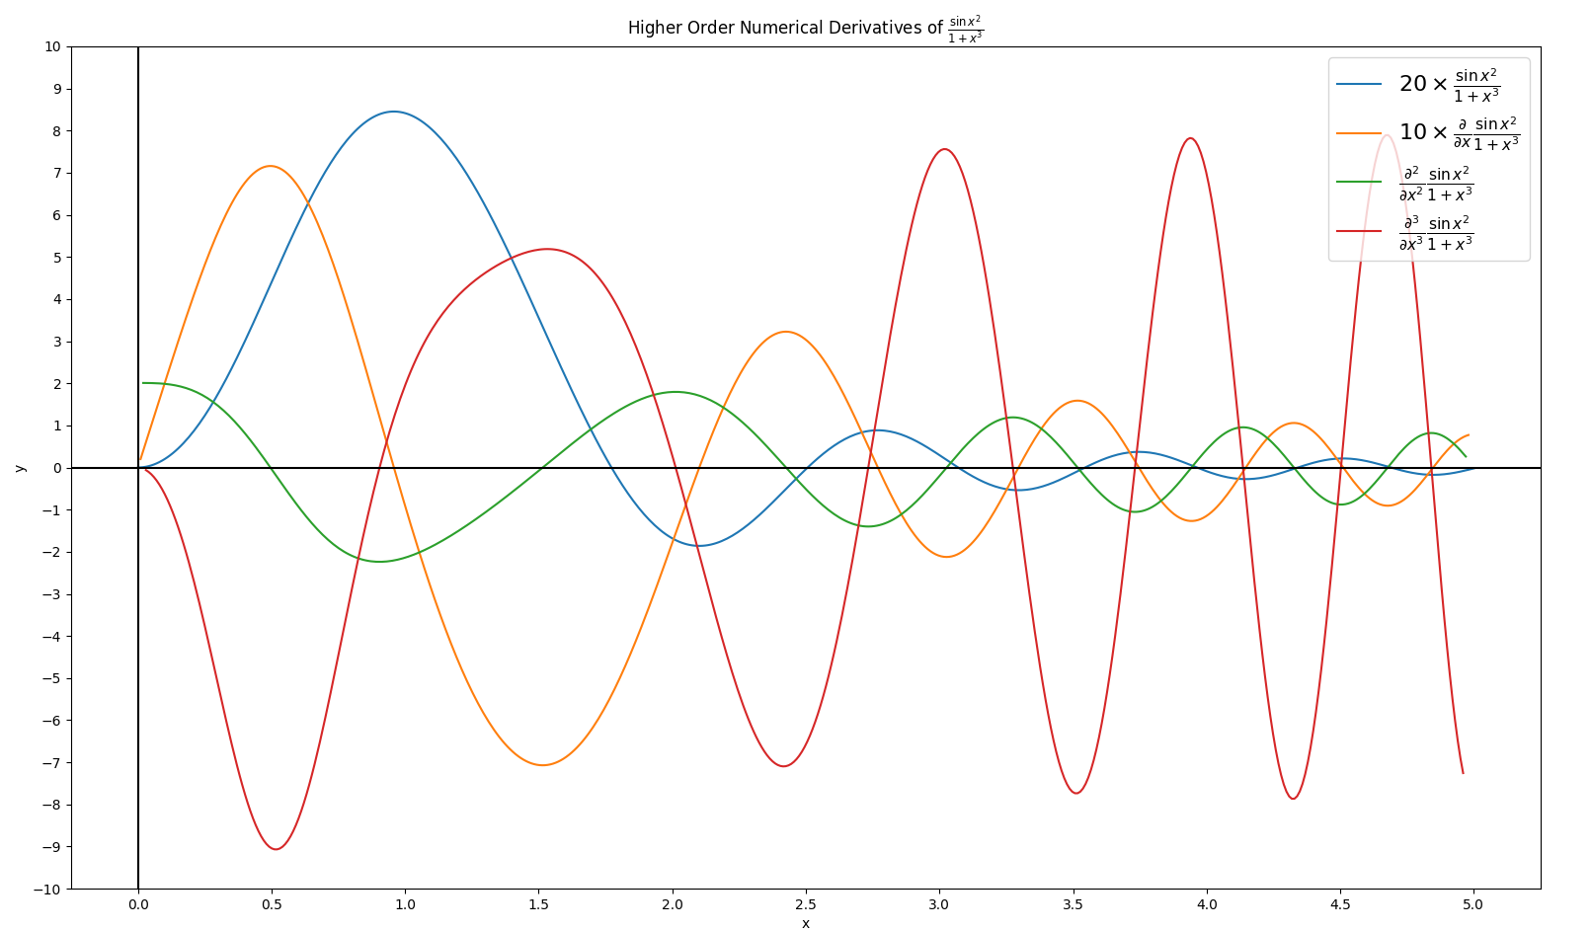
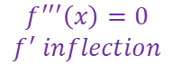
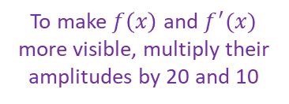
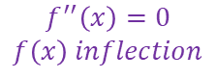
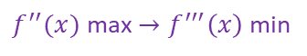
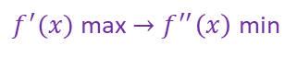
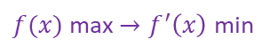
Run third_derivative.py
To make $f\left(x\right)$ and $f^{′}(x)$ more visible, multiply their amplitudes by 20 and 10
$f(x)$ max $→f^{′}\left(x\right)$ min
$$f^{′′′}\left(x\right)=0$$
$$f^{′} inflection$$
$f^{′′}(x)$ max $→f^{′′′}\left(x\right)$ min
$$f^{′′}\left(x\right)=0$$
$$f\left(x\right) inflection$$
$f^{′}(x)$ max $→f^{′′}\left(x\right)$ min

Slide 18
Why do we need integrals?
How to calculate the total change in a variable X
When variable X depends on the changes in variable Y…
… and variable Y depends on the changes in variable Z…
… and variable Z is constantly changing…
Think about an accelerating car and the total distance it will travel in each number of seconds
The total distance depends on the velocity of the car…
… the velocity of the car depends on the acceleration
… and the acceleration is constantly changing

Slide 19
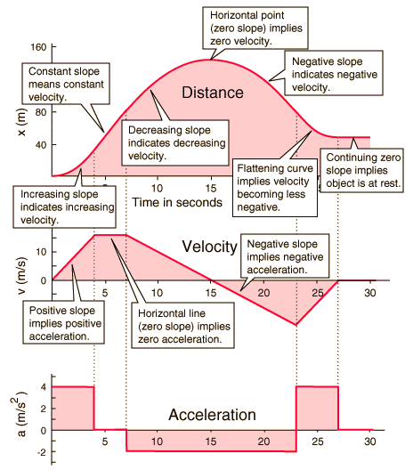
Why do we need integrals?

Slide 20
Why do we need integrals?

Slide 21
Why do we need integrals?
s
s
Differentiate
v
v
Integrate
a
a

Slide 22
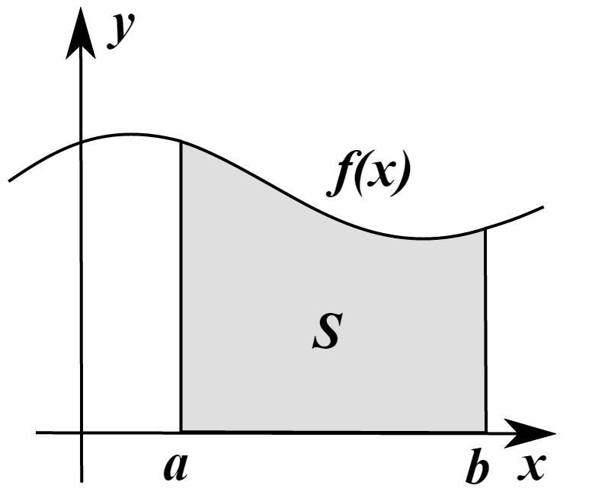

Why do we need integrals?
The integral of a function can be defined as the area under the curve f(x) within the region [a,b]
Sometimes there are methods to determine exactly the value of the integral of f(x) which we would write as $F\left(x\right)=\int_{a}^{b}{f(x)}$
However, sometimes it is not possible to find an analytic expression for $F\left(x\right)$– so we use numerical integration

Slide 23

Riemann Sums
One way we can integrate f(x) is to divide the area under the curve into strips (intervals) and sum the area of each strip
This estimate may not be totally accurate because we might have gaps between the true value of f(x) and the top of a strip

Slide 24

Riemann Sums
The width of each strip is $Δx= \frac{(b−a)}{\# of intervals}$
We can minimize the gaps by increasing the number of intervals, which makes the $Δx$ smaller
There are different strategies for determine the shape and height of each strip
Left-hand Rule, Right-hand Rule, Midpoint Rule
Fit Trapezoids
Fit Parabolas (Simpson’s Rule)
Depending upon the shape of $f(x)$, one method might be more accurate than the others

Slide 25




Riemann Sums
Left-Hand
Midpoint
Trapezoids
Parabolas
(Simpson’s Rule)

Slide 26




Deriving Simpson’s Rule

Slide 27


Deriving Simpson's Rule
Interval #1
$$1y_{2}+…)$$

Slide 28
Deriving Simpson's Rule
Interval #2
$$2y_{2}+4y_{3}+1y_{4}…)$$

Slide 29
Deriving Simpson's Rule
Interval #3
$$2y_{2}+4y_{3}+2y_{4}+4y_{5}+1y_{6}+…)$$

Slide 30
Deriving Simpson's Rule
Interval
# n

Slide 31


Deriving Simpson's Rule
$$a$$
$$b$$

Slide 32


Using Simpson's Rule
$$F\left(x\right)=\int{x^{5}−{2x}^{4}−120x^{3}+22x^{2}+2119x+1980ⅆx}$$
$$(x+9)(x+4)(x+1)(x−5)(x−11)$$

Slide 33



Using Simpson's Rule
$$=\int_{−10}^{12}{x^{5}−{2x}^{4}−120x^{3}+22x^{2}+2119x+1980ⅆx}$$
$$=\left(\frac{x^{6}}{6}−\frac{2x^{5}}{5}−30x^{4}+\frac{22x^{3}}{3}+\frac{2119x^{2}}{2}+1980x\right)\left|\begin{matrix}12 \\ \\ −10\end{matrix}\right.$$
$$\left[\frac{−174744}{5}−\frac{−43550}{3}\right]=\frac{−306482}{15}=−20432.13333$$

Slide 34

Open simpsons_rule.py
Compare the percent error in the estimate of the integral provided by the left-hand rule vs. Simpson’s rule

Slide 35


View simpsons_rule.py
In Python we often pass a "function" name as a parameter so a separate function can then call it

Slide 36

Run simpsons_rule.py
Sometimes dealing with a tiny bit more complexity is more than worth it!

Slide 37

https://www.scipy.org

Slide 38


https://www.scipy.org

Slide 39


Area of a Unit Circle
Estimate the area of a unit circle centered at the origin
using this integrand based upon its conic section
$$F\left(x\right)=4\int_{0}^{1}{\sqrt{1−x^{2}}ⅆx}$$

Slide 40





$$F\left(x\right)=4\int{\sqrt{1−x^{2}}ⅆx}$$
$$F\left(x\right)=2\left(x\sqrt{1−x^{2}}+\sin^{−1}\left(x\right)\right)+C$$
$$4\int_{0}^{1}{\sqrt{1−x^{2}}ⅆx}$$
$$F\left(0\right)=2\left(0\sqrt{1−0^{2}}+\sin^{−1}\left(0\right)\right)=0$$
$$F\left(1\right)=2\left(1\sqrt{1−1^{2}}+\sin^{−1}\left(1\right)\right)$$
$$F\left(1\right)=2\left(\frac{π}{2}\right)=π$$

Slide 41

Open circle_area.py
①
②
③
④

Slide 42


View circle_area.py
①
$$F\left(x\right)=4\int_{0}^{1}{\sqrt{1−x^{2}}ⅆx}$$
②
③
④
⑤
⑥
⑦

Slide 43


Run circle_area.py
$$4\int_{0}^{1}{\sqrt{1−x^{2}}ⅆx}=π$$
SciPy uses a high-order adaptive Gaussian quadrature algorithm

Slide 44


Cumulative Distribution Function
Estimate the probability that a normally distributed random variable will fall within $±$ the first standard deviation $\left(σ\right)$ of its mean $\left(μ\right)$
The integral (the area under the curve) of a probability distribution function (PDF) indicates the probability an observation will fall within that interval
Assume we have a standard normal distribution for this problem

Slide 45




Open stdnormal_area.py
Using the scipy quadrature function, estimate the area under the standard normal curve
from $−1$ to $1$
①
②
$$f\left(x\right)=\frac{1}{σ\sqrt{2π}}e^{\frac{−{\left(x−μ\right)}^{2}}{2σ^{2}}}$$
③
④
Is this area the same as the probability of a normally distributed random variable falling within the first standard deviation away from the mean?
For a standard normal distribution,
$μ=0$ and $σ=1$

Slide 46

Run stdnormal_area.py
Estimate the probability that a normally distributed random variable will fall within $±$ the first standard deviation $\left(σ\right)$ of its mean $\left(μ\right)$

Slide 47







Adaptive Quadrature
Calculate the following integral using the midpoint rule:
$$f\left(x+Δx\right)$$
This large $∆x$ makes
$$\left|\frac{f\left(x+Δx\right)−f\left(x\right)}{f\left(x\right)}\right|$$
exceed the limit
$$\int_{0}^{10}{5x^{3}−9x^{2}+11}$$
$$f\left(x\right)$$
$$Δx$$
Consider the function midpoint_adaptive() that, while using the midpoint area rule, will ensure that the absolute relative change in the function value between the left and right side of any interval is $≤$ 0.001
We need to reduce $∆x$ to keep the absolute relative change in the function value across the interval $≤$ 0.001
The function midpoint_fixed() is set to use 1 million fixed width intervals. How does the midpoint_adaptive() quadrature compare in terms of relative % error and overall execution time?

Slide 48


Open adaptive_quadrature.py
①
$$\int_{0}^{10}{5x^{3}−9x^{2}+11}$$
②
③
④
⑤
⑥
⑦
⑧
⑨
⑩

Slide 49




View adaptive_quadrature.py
$$f\left(x\right)=\int{5x^{3}−9x^{2}+11}$$
①
$$F\left(x\right)=\frac{5x^{4}}{4}−3x^{3}+11x$$
②
①
②
$$\int_{0}^{10}{5x^{3}−9x^{2}+11}=9610$$

Slide 50





View adaptive_quadrature.py
①
②
③
$${Δx}_{fixed}$$
$${Δx}_{variable}$$

Slide 51

View adaptive_quadrature.py
①
②
③
④
⑤
⑥

Slide 52

Run adaptive_quadrature.py
Sometimes dealing with a tiny bit more complexity is more than worth it!

Slide 53
Oscillating Integrands
SciPy’s quad() uses an adaptive Simpson’s rule integrator with a default maximum limit of 50 subintervals into which any given integration interval can be divided (based on the rate of change of the function within that interval)
If your integrand is highly oscillatory across your limits of integration, the quad() numerical estimate may fail to capture the high-frequency extrema points
In these more extreme situations, we can improve SciPy’s quad()’s accuracy by specifying a greater subinterval limit
This additional processing may significantly slow down the response time of quad()

Slide 54







Open oscillating_integrand.py
③
①
$$f\left(x\right)=\cos{x}$$
$$F\left(x\right)=\int{\cos{x}ⅆx}$$
②
$$F\left(x\right)=\sin{x}+C$$
④
$$=\int_{0}^{5000}{\cos{xⅆx}}$$
$$=\sin\left(5000\right)$$
$$=−0.987963…$$
⑤
⑥

Slide 55

Run oscillating_integrand.py

Slide 56


View oscillating_integrand.py
①
②
③
④
⑤
☹
☺
☺

Slide 57
Irregular Integration
SciPy has a cumulative_simpson() function that uses an adaptive algorithm that can handle numerically estimating a quadrature even if the input domain is irregularly spaced
Irregular spacing will occur if you are unable to take samples of a function at a consistent interval or rate
It remains your responsibility to obtain enough range values within periods where your integrand is strongly or rapidly oscillating
But the cumulative_simpson() function can typically do an admirable job of estimating the integral even if presented with a few sample points that are randomly spaced

Slide 58



Open irregular_integration.py
①
$$y=\sin^{2}{θ}$$
②
$$\int_{0}^{π}{\sin^{2}{θ}}$$
②
③

Slide 59



View irregular_integration.py
$$\int_{0}^{π}{\sin^{2}{θ}}=\frac{π}{2}$$
①
②
③
④
⑤
⑥
⑦

Slide 60


Run irregular_integration.py

Slide 61


Scintillator Detectors

Slide 62







Scintillator Detectors
Compton Scattering
↑ Energy
↓ $λ$
Pure Sodium
Doped with Thallium
Photon Emission
↓ Energy
↑ $λ$

Slide 63
Scintillator Detectors – Phase 1
Photon Interaction: High-energy photons (gamma rays or X-rays) enter the scintillator material, typically composed of sodium iodide doped with thallium Na(Tl)
Energy Deposition: The incident photons interact with the scintillator material primarily through the photoelectric effect, Compton scattering, or pair production, depending on the photon energy
Light Emission: These interactions transfer energy to the scintillator material, causing it to emit light (scintillation). The amount of light emitted is proportional to the energy of the incident photon

Slide 64
Scintillator Detectors – Phase 2
Photomultiplier Tube (PMT): The emitted light photons are directed towards a photomultiplier tube or a similar light sensor
Electron Emission: The light photons strike the photocathode of the PMT, causing the emission of photoelectrons via the photoelectric effect
Signal Amplification: These photoelectrons are multiplied through a series of dynodes in the PMT, resulting in a measurable electrical pulse. The amplitude of this pulse is proportional to the number of photoelectrons, which is in turn proportional to the energy of the initial incident photon

Slide 65
Calculating Accumulated Charge
Most detectors measure a signal’s voltage
However, to identify photons having a specific energy, scientists evaluate the accumulated charge that is proportional to that voltage over time
The bridge between voltage and current is Ohm’s Law
If we know the internal resistance of the detector and we integrate the signal’s voltage over time, we can estimate the photon’s incident energy (current over time)
Most experiments look for matter interactions with specific photon energies and need to filter out background noise and other non-important interactions

Slide 66






Voltage, Current, Resistance
Potential Energy
Amount
of Flow
V = Voltage
Volts (V)
I = Current
Amps (A)
R = Resistance
Ohms ($Ω$)
Alessandro Volta
(1745 – 1827)
André Ampère
(1775 – 1836)
Georg Ohm
(1789 – 1854)

Slide 67




Voltage, Current, Resistance
Current
Ohm's Law
Volts
Resistance
$$V=IR$$
A Circuit
Schematic
James Watt
(1736 – 1819)
Joules (Energy) per second

Slide 68


Open scintillator_pulse.csv
16,390 data rows of Volt (V) readings spanning 32,778 ns $\left(32.78μs\right)$

Slide 69



Open scintillator_pulse.py
①
②
③
④
⑤
⑥
samples is a 2D numpy array (matrix)
samples = (16,390 rows X 2 columns)
.T = Matrix Transpose
samples.T = (2 rows X 16,390 columns)
time $→$ 1st row
volts $→$ 2nd row

Slide 70
Scintillator Detectors – Region of Interest
Scientists study a specific region of interest (ROI) in the plot of the accumulated charge in a scintillator detector to aid in the discrimination of incident photon energies
The maximum slope region can provide information about the initial amplitude of the pulse. Since the maximum slope of the rising edge is proportional to the incident photon’s energy, accurately capturing this region helps in precise energy determination
This part of the curve provides the best timing resolution and lowest signal-to-noise (SNR) ratio, allowing for precise determination of the start of the scintillation event and accurate pulse height analysis

Slide 71

View scintillator_pulse.py
①
②
③
④
⑤
⑥
⑦

Slide 72


Broadcasting and Element-wise Comparison
①
1.) The scalar 2 is broadcasted into a temporary array with same dimensions as array x
②
③
2.) Element-wise comparison is conducted, returning an array of bool indicating the result of the comparison for every element in array x
④
3.) Array c holds the logical AND of each element in array a with the corresponding element in array b
⑤
4.) The array x[c] contains only those elements in array x where the corresponding element in array c is True $→\left(3≤x≤7\right)$
①
②
③
④
⑤

Slide 73

View scintillator_pulse.py
①
②
③
④
⑤
⑥

Slide 74



Run scintillator_pulse.py
1st time in the ROI $f^{′′}\left(x\right)$ significantly changes sign
1st time $f^{′}\left(x\right)$ significantly changes

Slide 75
Session 10 – Part 2 of 2 – Topics
Revisit the Fundamental Theorem of Algebra using NumPy's roots() and SciPy’s optimize.fsolve() functions
Use the SciPy Optimization module to numerically locate the global minima of a trigonometric function
Use the SciPy Interpolate module to estimate the density of photons across an energy spectrum and to determine the percentage of those photons that are within a specific energy window
Numerically estimate Dirichlet's pathological function and appreciate that nowhere continuous functions may have a Lebesgue Integral

Slide 76

Root Finding
In 1799, Gauss (for his doctoral dissertation) proved the Fundamental Theorem of Algebra showing that every polynomial of degree 𝑛 (with $n>0$) has exactly 𝑛 roots in the complex number system, counting multiplicities
This means that every polynomial of degree 𝑛 can be factored into 𝑛 linear factors over the complex numbers and that any complex roots must come in conjugate pairs
However, this rule only applies to polynomials with integer exponents
We will compare NumPy's roots() and SciPy’s fsolve() because we must remain vigilant when trusting solutions

Slide 77

NumPy's Polynomial Class

Slide 78

NumPy's roots() Function

Slide 79

SciPy’s fsolve() Function

Slide 80

Complex Roots – Equation #1
Consider the equation:
With a degree (leading power) of four, there should be four total roots (real or complex, unique or repeated):
Four real
Two real, two complex (a single conjugate pair)
Four complex (two conjugate pairs)
Most solvers do better if you can give them hints on where to search for the zeros, so we should first plot the function to see if we can estimate where the zeros might be located
$$f\left(x\right)=x^{4}+x−1$$

Slide 81


Open eqn1_plot.py
①
$$f\left(x\right)=x^{4}+x−1$$
②
③
④

Slide 82

Run eqn1_plot.py
In the real plane, we see only two zeros, so the other two roots must form a complex conjugate pair

Slide 83

Open eqn1_roots.py
①
②
We don’t want 0.000j to be displayed for real numbers
③
④
⑤
⑥
⑦
Note: this only activates when printing numpy arrays, not individual scalars

Slide 84
NumPy’s Data Types
Identifier | _kind Type | NumPy dtype
b | boolean_kind | np.bool_
i | integer_kind | np.int8, np.int16, np.int32, np.int64
u | unsignedinteger_kind | np.uint8, np.uint16, np.uint32, np.uint64
f | float_kind | np.float16, np.float32, np.float64
c | complex_kind | np.complex64, np.complex128
O | object_kind | Represents generic Python objects: np.object_
S | bytes_kind | Represents fixed-length ASCII string data types: np.bytes_, np.string_
U | unicode_kind | Represents fixed-length Unicode string data types: np.unicode_
V | void_kind | Represents raw data (void data type): np.void

Slide 85



View eqn1_roots.py
①
SciPy’s fsolve() requires a hint and can only find one real root at a time
②
③
$$f\left(x\right)=x^{4}+x−1$$
$$−1+1x+0x^{2}+0x^{3}+{1x}^{4}$$
④
⑤
⑥
We need to verify that each reported root is indeed a solution
Broadcasting and Element-wise Comparison

Slide 86


Run eqn1_roots.py
$$f\left(x\right)=x^{4}+x−1$$
$f(x)$ has two real and two complex roots (in a single conjugate pair)
SciPy’s fsolve() could only find the two real roots ☹
①
Conjugate Pair
NumPy’s roots() found all four roots ☺
We like NumPy! The roots() solver doesn’t require hints and can typically find all the roots, real or complex.
But this API has a severe limitation!

Slide 87



Complex Roots – Equation #2
We can’t use np.roots() because of the fractional exponent!
$$g\left(x\right)=−x^{2}+x^{\frac{3}{2}}+5x−6=0$$
$$x^{\frac{3}{2}}=x^{2}−5x+6$$
Let’s try a trick to eliminate the fractional exponent:
square both sides!
$${\left(x^{\frac{3}{2}}\right)}^{2}={\left(x^{2}−5x+6\right)}^{2}$$
$$x^{3}=x^{4}−10x^{3}+37x^{2}−60x+36$$
Now we can use np.roots() because the exponents are all integers
$$x^{4}−11x^{3}+37x^{2}−60x+36=0$$

Slide 88


Open eqn2_plot.py
$$g\left(x\right)=−x^{2}+x^{\frac{3}{2}}+5x−6=0$$
①
②
③
https://realpython.com/python-raw-strings

Slide 89

Run eqn2_plot.py
How many roots should this equation have?

Slide 90


Open eqn2_roots.py
$$g\left(x\right)=−x^{2}+x^{\frac{3}{2}}+5x−6=0$$
①
②
③
④

Slide 91

Run eqn2_roots.py
$$g\left(x\right)=−x^{2}+x^{\frac{3}{2}}+5x−6=0$$
SciPy found the two correct real roots ☺
①
Conjugate Pair
The errant conjugate pair of roots is because we were solving for:
$$x^{4}−11x^{3}+37x^{2}−60x+36=0$$
Always verify the reported roots for your initial equation!

Slide 92



Complex Roots – Equation #3
We can’t use np.roots() because of the fractional exponent!
$$h\left(x\right)=x^{3.4}+x−1=0$$
We also cannot apply the fundamental theorem of algebra
Let’s try the trick to eliminate the fractional exponent:
Raise both sides by 5
$$x^{\frac{34}{10}}=1−x$$
$${\left(x^{\frac{34}{10}}\right)}^{5}={\left(1−x\right)}^{5}$$
$$x^{17}=−x^{5}+5x^{4}−10x^{3}+10x^{2}−5x+1$$
Now we can use np.roots() because the exponents are all integers
$$x^{17}+x^{5}−5x^{4}+10x^{3}−10x^{2}+5x−1=0$$

Slide 93

Run eqn3_plot.py
How many roots should this equation have?

Slide 94

Open eqn3_roots.py
①
②
③
④

Slide 95



Run eqn3_roots.py
$$h\left(x\right)=x^{3.4}+x−1$$
$$x^{17}+x^{5}−5x^{4}+10x^{3}−10x^{2}+5x−1=0$$
①
17 roots!
Conjugate Pair
For the 17 roots reported for our “trick” polynomial, only three are actual roots for the given $h(x)$

Slide 96
Root Finding with SymPy
Ideally, we would like a Python package that would return only the valid roots (real or complex) of any equation without having to give any search hints and without having to apply any special exponentiation tricks
Unfortunately, no such package exists – no solver (numerical or analytical) can guarantee it will find every root
We can try to use the SymPy (not SciPy) analytic solver, which will switch to finding numerical roots if the polynomial does not have integer exponents
However, SymPy’s root finder can get stuck in an infinite loop if it can’t find solutions, so we need to guard for that

Slide 97

SymPy’s Approach
https://docs.sympy.org/latest/guides/solving/find-roots-polynomial.html

Slide 98

Open roots_sympy.py
Note: this only activates when printing numpy arrays, not individual scalars
①

Slide 99

View roots_sympy.py
③
④
①
②

Slide 100

View roots_sympy.py
①
②
③
④

Slide 101


Python’s Multiprocessing

Slide 102

View roots_sympy.py
⑥
⑦
⑧
①
②
③
④
⑤

Slide 103
View roots_sympy.py
①
②
③
④
⑤

Slide 104
View roots_sympy.py
①
②
③
④
⑥
⑦
⑧
⑨
⑩

Slide 105

Run roots_sympy.py
①
②
③
④
⑤
⑥
⑦

Slide 106



The Ladder Problem
$$C_{2}=1m$$
What is the maximum length straight ladder than can fit around this corner?
Note: the ladder must always maintain a constant length
$$C_{1}=2m$$
$$θ$$

Slide 107

The Ladder Problem
Create a Python program called ladder_problem.py that uses SciPy to calculate and display the maximum ladder length possible that will fit around the corner depicted on the prior slide
Additionally, using pyplot, graph the function describing the maximal ladder length as a function of $θ$ (see following diagram)
Finally, plot the point where this function has a zero rate of change

Slide 108


The Ladder Problem
$$C_{2}=1m$$
What is the maximum length straight ladder than can fit around this corner?
$$L=L_{1}+L_{2}$$
$$L=\frac{2}{\sin{θ}}+\frac{1}{\cos{θ}}$$
Because the ladder length must be constant, its rate of change (first derivative) must be zero!
$L^{′}\left(θ\right)=0$ at an extrema point which happens to be the minimum
$$L_{2}$$
$$L_{2}\cos{θ}=C_{2}$$
$$θ$$
$$L_{2}=\frac{1}{\cos{θ}}$$
$$L_{1}$$
$$C_{1}=2m$$
$$θ$$
Note: the ladder must maintain a constant length $L$ throughout
$$0^{°}≤θ≤{90}^{°}$$
$$L_{1}\sin{θ}=C_{1}$$
$$L_{1}=\frac{2}{\sin{θ}}$$

Slide 109


Slide 110


Slide 111


Open ladder_problem.py
①
②
③
④
⑤
Where the values
are “constant”
⑥
⑦
⑧

Slide 112


Run ladder_problem.py

Slide 113



Because the ladder length must be constant, the rate of change (first derivative) of the ladder length must be zero
(at an extrema point which happens to be the minimum)
Not at $45°$

Slide 114
Interpolation of Photon Spectrum Data
Treating cancer tumors via the radiation of photon beams requires carefully tuning the emitter, as only photons within a specific energy (MeV) range will penetrate the tissue and break up the tumor
It is also important that the beam shines only for a specific duration to ensure enough energy is deposited in the tumor while minimizing collateral damage to surrounding healthy tissue
When designing and utilizing photon emitters for cancer treatment, scientists often need to know what percentage of all photons emitted will fall within a specific energy envelope

Slide 115

Radiation Therapy via Photon Beams
Hershey Medical Center

Slide 116

Open photon_spectrum.txt
There is no header row
The values are separated by a space, not a comma
18 rows of 2 columns - Photon Energy (MeV) vs. Photon Density

Slide 117

Plot of Photon Spectrum Discrete Data Points

Slide 118
Interpolation of Photon Spectrum Data
How could we calculate the percentage of photons from that emitter that fall in the range [2.12 … 3.14] MeV?
We don’t have a closed-form (analytic) formula providing the energy density (aka “photon count”) as a function of photon energy
We need to interpolate - to fit a series of smooth curves between the discrete data points - and then integrate those smooth curves
The ratio of the integral of the energy-density curve within the desired range, divided by the integral of the entire emitter range, will provide the percentage we seek

Slide 119

Cubic Spline Interpolation

Slide 120

Open photon_spectrum.py
①
②
1-dimensional interpolation
③
④

Slide 121

View photon_spectrum.py
①
②
③
④
⑤
⑥
⑦
⑧
interp1d() returns an “interpolation object” which can then act as a callable function that is
vector aware (supports vectorized operations)

Slide 122

View photon_spectrum.py
①
②
③
④
⑤

Slide 123

Run photon_spectrum.py

Slide 124

Dirichlet's Pathological Function
The Dirichlet function is defined as
$$f\left(x\right)=\lim_{k→∞}\left\{\lim_{n→∞}\left[{\cos\left(k!∙πx\right)}^{2n}\right]\right\}$$
Use the mpmath package for Python (https://mpmath.org/doc/current) to calculate and display the values $f\left(2\right), f\left(2.5\right), f\left(\sqrt{2}\right),f(e)$
Functions like mpmath.power(), mpmath.cos(), and the mpmath.factorial() functions, along with the mpmath.pi constant, will handle large numbers
There are many videoes on the Dirichlet function, such as https://www.youtube.com/watch?v=LeGWPuRdetM

Slide 125


Open dirichlet_function.py
①
$$f\left(x\right)=\lim_{k→∞}\left\{\lim_{n→∞}\left[{\cos\left(k!∙πx\right)}^{2n}\right]\right\}$$
④
⑤
⑥
⑦
⑧
https://mpmath.org/doc/current/general.html#chop
②
③
⑨
⑩
11

Slide 126



Run dirichlet_function.py
Rational
Rational
Irrational
Irrational

Slide 127


Real Analysis
Henri Lebesgue
(1875-1941)
Riemann Integral
Lebesgue Integral

Slide 128

Session 10 – Now You Know…
We can numerically estimate a first derivative using Fermat's Difference Quotient and higher-order derivatives using Newton's Difference Quotient
$$f^{\left(n\right)}\left(x\right)=\lim_{h→0}{\frac{1}{h^{n}}\sum_{k=0}^{n}{{\left(−1\right)}^{k+n}}\left(\begin{matrix}n \\ k\end{matrix}\right)f\left(x+kh\right)}$$
Using Simpson's Rule provides better estimates for most integrands because it fits a parabola to the top of the interval to better match a curving function
The adaptative quadrature approach gains greater accuracy in regions of high rates of change and gains speed across relatively flat regions versus using fixed width intervals

Slide 129

Session 10 – Now You Know…
The SciPy Integration module, with its quad() function, provides a highly efficient and accurate numerical integrator
The integral of the PDF for the Standard Normal distribution between -1 to 1 is the same as the probability a random variable will fall within one standard deviation
Pathological functions like Dirichlet's demonstrate the nowhere continuous property but do have a Lebesgue measure
The Weierstrass function is everywhere continuous but nowhere differentiable
$$f\left(x\right)=\sum_{n=0}^{∞}{a^{n}\cos\left(b^{n}πx\right)}$$

Slide 130

Task 10-01
Create a Python program called archimedes_spiral.py that uses SciPy to calculate and display the arc length of an Archimedes Spiral with $r=θ$ as it rotates from $0≤θ≤8π$
Using pyplot, make a graph of the entire spiral
Upload your solution to the BNL QIS102 SharePoint site

Slide 131

Task 10-02
Create a Python program called eulers_constant.py that uses SciPy to numerically estimate Euler's Constant:
$$γ=−\int_{0}^{1}{\ln{\ln\left(\frac{1}{x}\right)}ⅆx}$$
Then use pyplot to superimpose a line graph of $γ+\ln\left(x\right)$ on top of a step plot of the first 50 Harmonic Numbers
Upload your solution to the BNL QIS102 SharePoint site

Slide 132

Task 10-03
Create a Python program called lead_attenuation.py that uses SciPy interpolation to compute and plot the estimated attenuation factor of a lead shield as a function of incident photon energy (MeV)
The number of photons $N$emerging from a lead shield is a function of distance$\left(x\right)$ traveled through the lead shield:
$N\left(x;E\right)=N_{0}e^{−μ\left(E\right)x}$
where $N_{0}$ is the number of initial photons hitting the shield and $μ\left(E\right)$ is the lead attenuation factor that depends on a given photon’s energy $\left(E\right)$
Hint: in many ways, this task will utilize code patterns like those shown in photon_spectrum.py

Slide 133

Task 10-03
In the file lead_attenuation.txt, the 1st column contains a given photon’s energy (MeV), and the 2nd column contains the lead shield’s attenuation factor for that energy
Using a semi-log scale on the y-axis, display the file data as a scatter plot, and then use cubic spline interpolation to draw a smooth curve passing through those discrete points
Based upon the interpolated function, calculate the attenuation coefficient for a photon with 4.65 MeV energy
Having that $μ\left(4.65\right)$ value, then calculate the percent of photons passing through a lead shield that is 2 cm thick
Upload your solution to the BNL QIS102 SharePoint site

Slide 134

Task 10-03 (Hint)

